Slide 1
Is the No-miracles Argument Redundant?
Korea Science Academy of KAIST
Bon-Hyuk Koo

Slide 2
Plan
The No-miracles Argument (NMA)
Truth and NMA
Intensional scientific Realism and extensional scientific realism
NMA is not redundant
Conclusion (and thoughts)

Slide 3
The No-miracles Argument
NMA: the ‘ultimate argument for scientific realism’ (van Fraassen 1980: 39, Musgrave 1988)
Putnam: “The positive argument for realism is that it is the only philosophy that doesn’t make the success of science a miracle” (1975: 73).
Realism is seen as a theory, success its evidence.
“[NMA] is arguably the most influential argument in favour of scientific realism” (Dawid & Hartmann 2018: 4063)

Slide 4
The No-miracles Argument
Some philosophers of science have argued that the best arguments for scientific realism is the evidence scientists suggest for each scientific theory that scientific realists are committed to. (Bird 1998, Park 2016)
If so, NMA is not the ultimate argument for scientific realism after all. It can be reducible, or worse, redundant.

Slide 5
NMA and Truth(Minimalist Theory)
Bird (1998: 141-143) aims to show that NMA adds nothing in terms of confirming scientific realism, considering two theories of truth.
The minimalist or deflationary view of truth: truth as contentless notion, not a property. (If property at all, a logical property)
The minimalist conception of truth defines truth with the equivalence schema: It is true that p if and only if p. (Horwich 1990)
By the equivalence schema, asserting that a scientific theory T is true is equivalent to asserting that T.

Slide 6
NMA and Truth(Correspondence Theory)
The correspondence theory of truth:
p is true iff p corresponds to the fact that p.
Hence, the property of truth depends on:
(1) a certain fact that p, and
(2) a correspondence relation between the fact and the proposition p
“[I]f a proposition p has any explanatory power over and above the explanatory power of the corresponding fact that p, then that additional power must be by virtue of its linguistic structure and meaning. But such things are unlikely to contribute much to the success of science. So if the truth of S explains anything, then this will be by virtue of the fact that corresponds to S.” (Bird 1998: 142, emphasis added)

Slide 7
Truth and NMA: Explanandum
Regarding the explanandum, Bird takes the success of scientific theories to be just the conjunction of all the scientific evidence.
Therefore, NMA is rendered as nothing more than the amalgamation of the scientific arguments for each of the individual scientific theories based on each theory’s evidence.

Slide 8
Truth and Scientific Realism
Asay (2017) on theories of truth and scientific realism:
“realists need to commit not just to the (approximate) truth of scientific theories but also to some sort of mind-independent reality of unobservable objects that grounds the truth of scientific theories” (2017: 392)
Otherwise, Asay recommends neutrality for methodological reasons.
Some scientific realist positions will be partisan to certain theories of truth, e.g. Kitcher’s “modest correspondence theory of truth”.
The two ‘extremes’ Bird (1998) considers all fall in the range of ‘mind-independent reality’.

Slide 9
Truth and NMA
IBE: used by scientists in scientific practice, adjudicating between competing scientific theories, influencing direction of research etc.
However, there are claims other than straightforward scientific claims that call for comparison in the scientific realism debate:
  Constructive empiricism
  Instrumentalism
  Social constructivism
Proponents of these positions can agree with realist scientists about all the observations and still offer alternative explanations of the success of science.

Slide 10
Truth and NMA
The alternative anti-realist explanations are based on the problem of underdetermination, pessimistic induction, the recurrent problem of unconceived alternatives etc.
These are distinctly philosophical problems. Scientists’ reasoning may not always be best suited for discounting these philosophically motivated anti-realist explanations. More empirical data won’t do it. (Indeed, some scientists did commit to anti-realist positions - e.g. Ernst Mach, Niels Bohr.)

Slide 11
Truth and NMA
Currently, most natural scientists seem to be realist and yet neutral about the possibility of doing science in a constructive empiricist/instrumentalist manner (Beebe & Dellsén 2020)
The realist consensus does not change the fact that there are anti-realist philosophical positions consistent with the scientific evidence, e.g. constructive empiricism.
The evidence scientists point at can be consistently converted into anti-realist-compatible version.
NMA is required to warrant the realist conclusion as the best explanation of the success of science whichever theory of truth one might adopt.

Slide 12
Intensional Scientific Realism &
Extensional Scientific Realism
Park (2016) introduces the distinction of extensional scientific realism and intensional scientific realism.
Two ways to pick out bachelors: extensionally (Heung-min Son, RM of BTS, GD, …) and intensionally (adult males never married)
Extensional scientific realism (ESR): choose believable scientific theories enumeratively by relying on the scientific evidence for each of the theories.
E.g. We should believe the general theory of relativity because of the light-bending observation near the sun and the successful explanation of the precession of Mercury’s perihelion.

Slide 13
Intensional Scientific Realism &
Extensional Scientific Realism
Intensional scientific realism (ISR): pick out believable theories in virtue of a common property.
E.g. False theories cannot be successful, so successful theories are (approximately) true. We should believe successful theories.
ESR and ISR pick out the same set of theories – just by different methods.
The unit of evaluation: individual theory (ESR) vs. a group of theories (ISR)
Comparison with other distinctions:
  Retail/wholesale realism (Magnus and Callender 2004)
  Local/global realism (Fitzpatrick 2013)

Slide 14
The Reductive Interpretation of NMA
Park’s interpretation of scientific realism and NMA:
Scientific realism, i.e. “successful theories are true”
= the evolutionary theory, the general theory of relativity theory, … are true
NMA: “merely a shorthand for all the arguments that scientists provided to support their successful theories”
E.g. “Light bends near the sun because spacetime is curved. It would be a miracle that light bends near the sun and yet spacetime is not curved. (The General Theory of Relativity)” (2016: 48)

Slide 15
NMA Is Not Redundant
NMA is still needed to provide the most consistent and persuasive framework for scientific realism.
A more nuanced global argument can be made. (“All theoretical entities of all successful and mature scientific theories exist” etc. – beating up a strawman!)
Realism based on a global argument (e.g. NMA based on the success-truth connection) need not be committed to all theoretical entities.
The degree of confidence in scientific theories may be distributed variedly across them, and furthermore, across theoretical constituents of each of them.
The degree of confidence could be based on many factors:
e.g. the degree and type of success
indispensability for generating the relevant success
the degree of coherent fit with other theories

Slide 16
NMA Is Not Redundant
This nuanced selective realist strategy focusing on the connection between success and truth is advantageous.
“This list of scientific arguments should be expanded to include all contents of a believable theory, all contents of the first-order evidence for it, all believable theories, and all first-order evidence for them in the science literature. … We can, however, avoid this grueling work thanks to the no-miracles argument.” (Park 2016: 48, emphasis added)
Individuation of scientific theories – a messy business.
(A theory of neutrino and a theory of top quarks, or the Standard Model?)
Vulnerability to pessimistic meta-induction (PMI)
Difficulty to accommodate theory modification/improvement

Slide 17
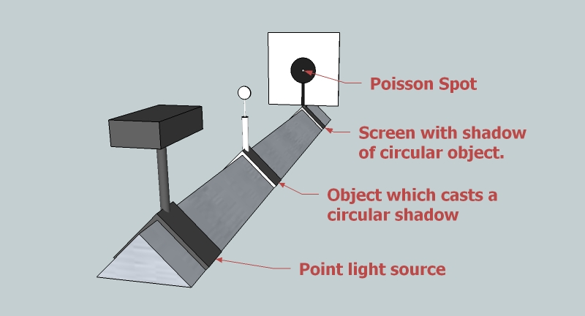
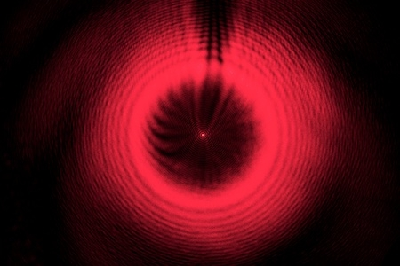
NMA Is Not Redundant
https://commons.wikimedia.org/wiki/File:Poissonspot_setup_treisinger.jpg
https://sciencedemonstrations.fas.harvard.edu/presentations/poissons-spot
An analogue: “Poisson’s spot appears because light is a wave in aether. It would be a miracle that Poisson’s spot appears and yet light is not a wave. (Fresnel’s wave theory of light)”

Slide 18
NMA Is Not Redundant
Scientists did get things wrong in the history of science.
PMI can threaten the support scientific evidence provides for theories.
Stanford’s ‘trust’ argument can apply to the level of scientists’ judgments on scientific theories.
Scientists’ arguments for their favourite theories aren’t enough.
The best way to defend realism: selective realism, deploying NMA that takes success to be evidence for the approximate truth of the theoretical constituents.

Slide 19
Conclusion (and Thoughts)
Regarding Bird’s attack on the redundancy of NMA based on theories of truth: NMA is still needed to fend off alternative anti-realist positions.
Regarding Park’s claim that NMA is merely a shorthand for scientists’ arguments for the respective scientific theories: NMA is still needed to provide the most consistent and persuasive framework for scientific realism against PMI and Stanford’s ‘trust’ argument.
Future tasks for realists: develop and defend selective realism by eliminating all potential counterexamples to NMA by case studies (Ladyman 2002 on PMI as an argument from counterexample; Lyons 2002 and Vickers 2013 for the “anomalies”)

Slide 20
Bibliography
Asay, J. (2017) ‘Realism and theories of truth’, in Saatsi, J. (ed.) The Routledge handbook of scientific realism. Routledge, pp. 383–393.
Beebe, J.R. and Dellsén, F. (2020) ‘Scientific realism in the wild: An empirical study of seven sciences and history and philosophy of science’, Philosophy of Science, 87(2), pp. 336–364.
Bird, A. (1998) Philosophy of science. Routledge.
Dawid, R. and Hartmann, S. (2018) ‘The no miracles argument without the base rate fallacy’, Synthese, 195(9), pp. 4063–4079.
Fitzpatrick, S. (2013) ‘Doing away with the no miracles argument’, in EPSA11 perspectives and foundational problems in philosophy of science. Springer, pp. 141–151.
Horwich, P. (1998) Truth. Clarendon Press.
Lyons, T.D. (2002) ‘Scientific realism and the pessimistic meta-modus tollens’, in Clarke, S. and Lyons, T.D. (eds.) Recent themes in the philosophy of science. Springer, pp. 63–90.
Magnus, P.D. and Callender, C. (2004) ‘Realist ennui and the base rate fallacy’, Philosophy of Science, 71(3), pp. 320–338.
Musgrave, A. (1988) ‘The Ultimate Argument for Scientific Realism’, in Nola, R. (ed.) Relativism and Realism in Science. Springer Netherlands (Australasian Studies in History and Philosophy of Science, 6), pp. 229–252.
Park, S. (2016) ‘Extensional scientific realism vs. intensional scientific realism’, Studies in History and Philosophy of Science Part A, 59, pp. 46–52.
Putnam, H. (1975) “What Is Mathematical Truth?”, in Philosophical Papers. Vol.1, Mathematics, Matter and Method. Cambridge: Cambridge University Press.
Van Fraassen, B.C. (1980) The Scientific Image. Oxford: Clarendon
Vickers, P. (2013) ‘A confrontation of convergent realism’, Philosophy of Science, 80(2), pp. 189–211.

